Slide 1
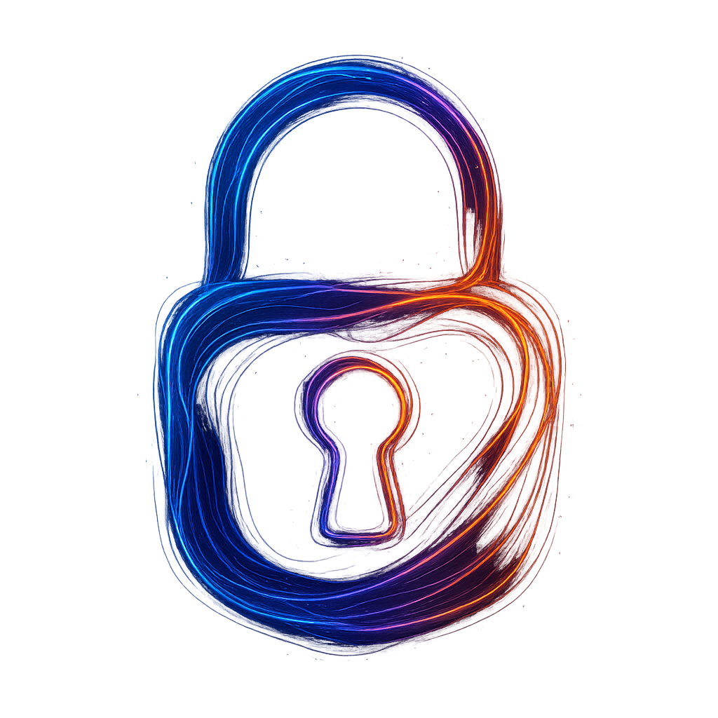
Quantum Cryptography
CS131 Spring 2025 Semester Project
Fady Attaalla

Slide 2
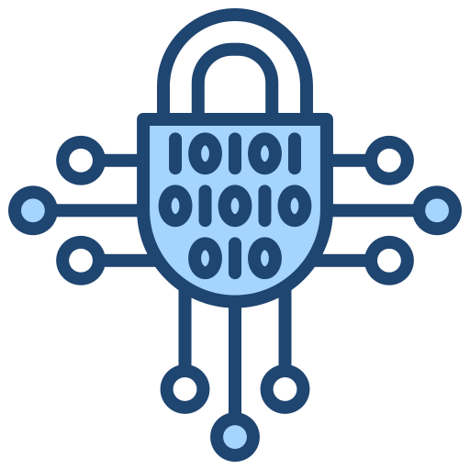
What is Cryptography?
The science of securing information
Messaging, banking, data storage, etc.
Symmetric Encryption and Asymmetric Encryption
Classical systems rely on hard math problems

Slide 3
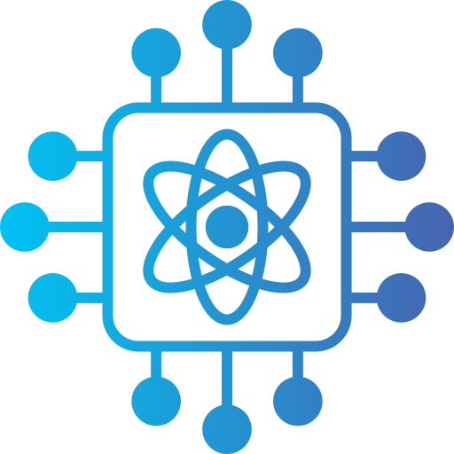
What is Quantum Cryptography?
Uses quantum physics to secure data
Quantum Key Distribution (QKD)
Based on no cloning theorem, and measurement disturbs quantum states

Slide 4

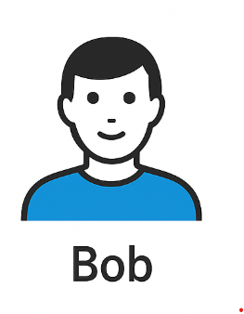
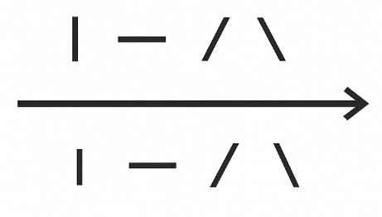
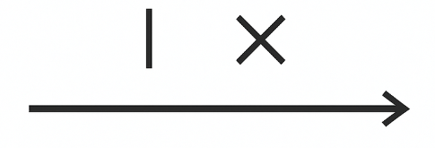
How Quantum Key Distribution(BB84 Protocol) Works
Alice sends photons with random polarization directions to Bob
Bob chooses basis for measurement randomly
Alice sends photon sequence: / — \ \ |
—
e.g., Alice for:
“+” basis: uses | for 1 and — for 0
“x” basis: uses / for 1 and \ for 0
Sifting
Alice Basis: x,+,x,x,+
Matching Basis:x,x,+
Final Bits: 1,0,1
Bob Basis: x,x,+,x,+
Alice and Bob compare bases publicly

Slide 5

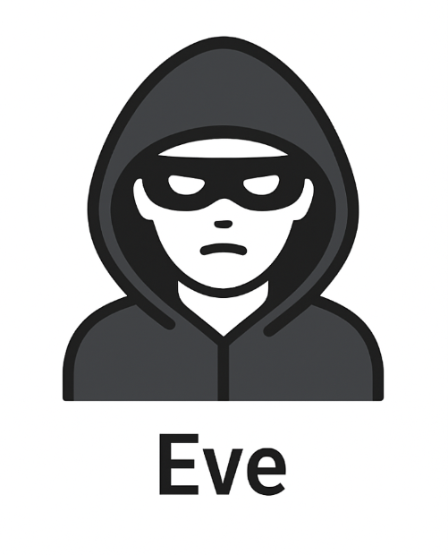
Why QKD is Secure
Quantum measurement disturbs the photon
Eve doesn’t know the right basis → makes random guesses
These wrong guesses introduce errors
Alice and Bob can detect Eves tampering by checking a sample of bits
If Eve guesses the wrong basis, Bob's measurement will likely be wrong.
?
Eve guesses basis and sends Bob a new photon

Slide 6

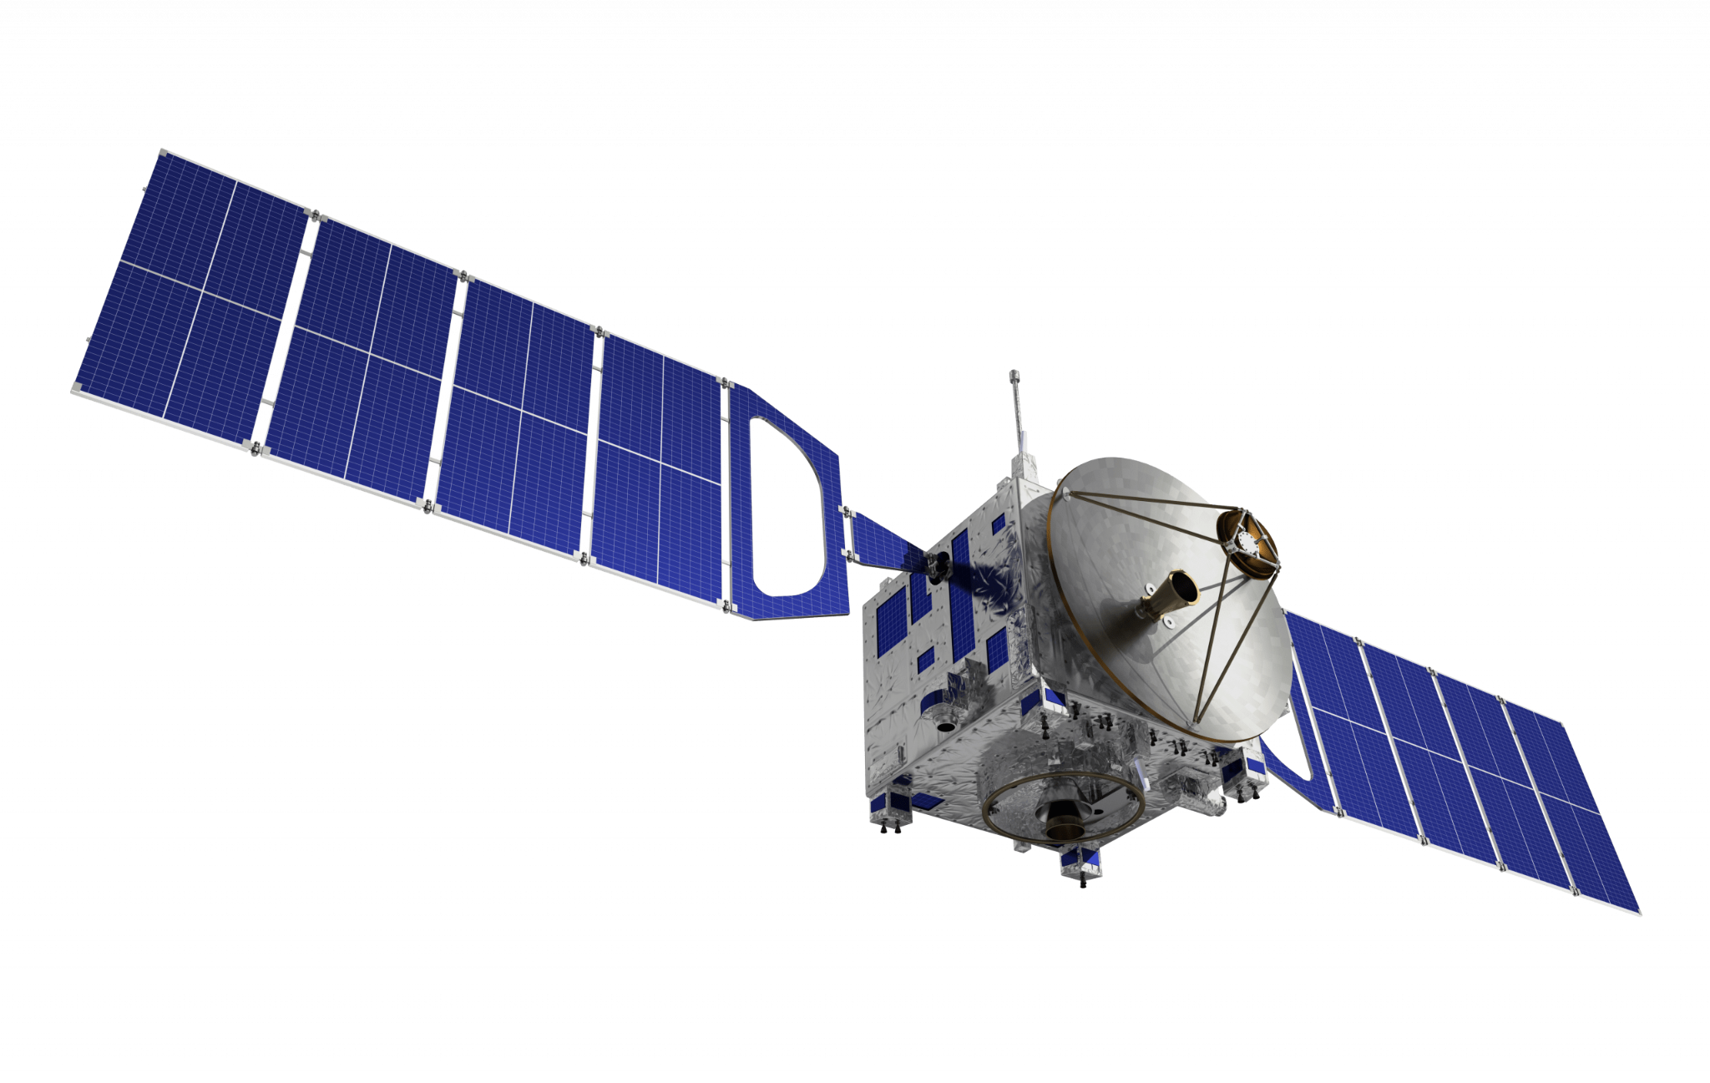
Real World Applications of QKD
Government & military: Secure diplomatic and defense communication.
Banks & finance: Quantum-safe data transmission.
Quantum satellites: Long-distance QKD (e.g., China’s Micius satellite).
Research & development: Europe, U.S., and Japan are testing quantum networks.

Slide 7
Challenges and Limitations of QKD
Limited distance over fiber (typically < 100 km without repeaters)
High cost of quantum hardware (detectors, single-photon sources)
Sensitive to environmental noise (e.g., fiber loss, air turbulence)
Requires trusted hardware & secure calibration
Integration with existing networks is still in development

Slide 8
Future Outlook
Toward a Quantum Internet: global-scale secure communications
Integration with classical networks (hybrid systems)
Ongoing research in quantum repeaters, long-distance QKD
Growing investment from tech companies and governments
QKD is a foundation for post-quantum security

